Slide 1


DevOps on Azure
Hugo Melendez
Technical Solution Professional

Slide 2

Digital Transformation and your customers
Notes:
Not just Microsoft… IBM, Google, … all technology vendors
Our typical Customer base and how they fit
What is Digital Transformation -> AE/PSS/SSP conversations
Cloud > Azure… Value for customers = Apps and Data
So our Digital Transformation stories tend to center around…

Slide 3
From traditional app to modern app
APP
Existing Application
Modern Infrastructure
Move to the cloud as VMs or Containers or refresh HW.
Modern Methodologies
Implement DevOps practices and automation.
Containerize Applications
Re-architect apps for scale with containers.
Modern Microservices
Add new services or start peeling off services from monolithic code.
Notes:
Multiple paths to modern app – examples
Typical MS Enterprise customer
Tell Eric Maloney story
Don’t gloss over methodologies – this session will reinforce why it is important and how to approach it
Begs the question, what is DevOps?

Slide 4

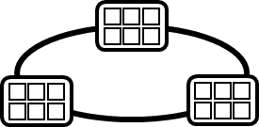
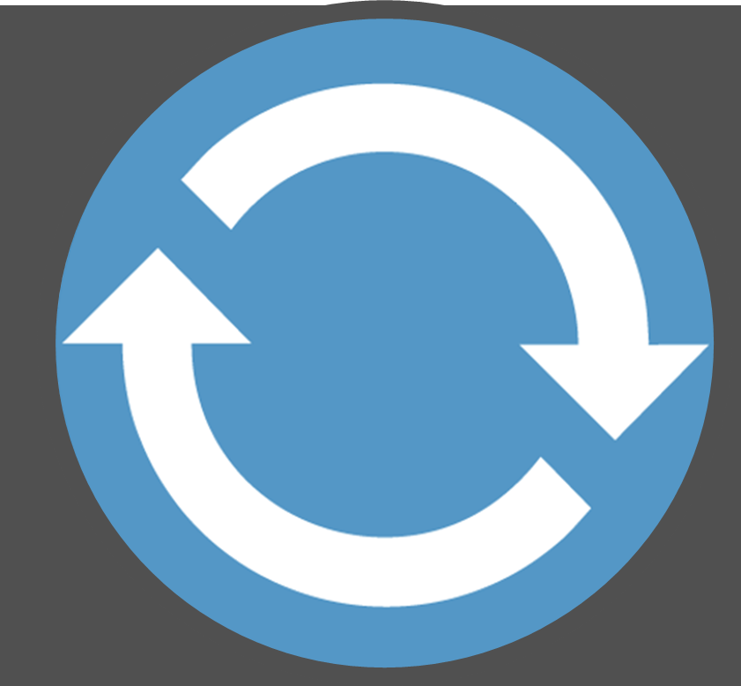
What is DevOps?
…
2.
3.
4.
5.
Run, Manage
…
Source Code Control
(SCC)
Build/CI,
Integrate,
Test
CD, Deploy
…
Production
environments
…
DevOps? Not Really!
…
Push
Code
…
1.
6.
…
Run
Code
Validate
Debug
Notes:
Typical description of a DevOps workflow (Build & Explain through #6)
Different vendors have different perspectives: GitHub, CloudBees and Jenkins, Chef, Amazon, …
Don’t get trapped by a myopic view based on tools…

Slide 5
The last 20 years…
Chasm of despair
Development
Operations
Develop
Test
Maintain
Provision
Stabilize
Deploy
Support
Translate business requirements to code
Focus on completing feature work on time with quality
Focused on faults, uptime and isolated automation
Focus on reliability, compliance, and financial management
Intermediaries, strict control, and long lead times to deploy

Slide 6

The next 20 years will be a period of alignment
Outcomes
Foundation
Reliable
Repeatable
Culture
Toolchain
Aspirational
Process
Platform

Slide 7
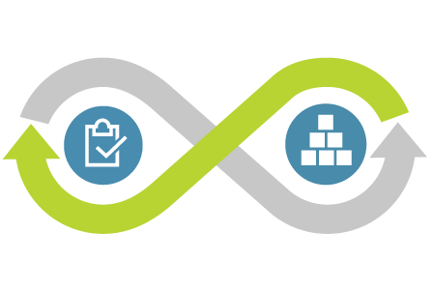
What is DevOps?
DevOps is the union of people, process, and tools to enable continuous delivery of value to our customers.
Increase flow of value
Shorten cycle times
Continuously Improve

Slide 8

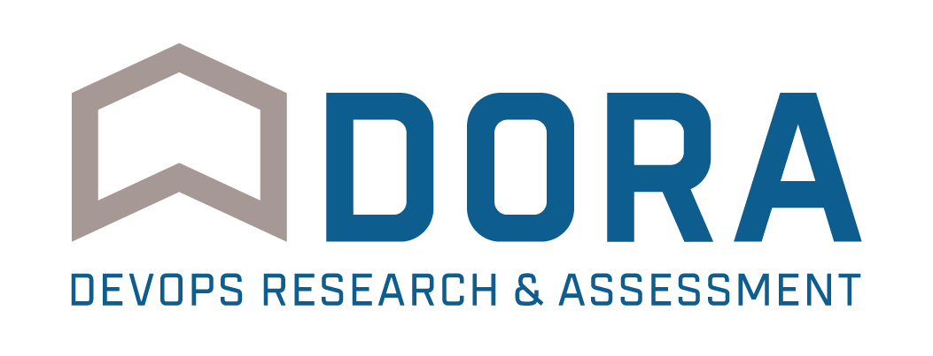
46x
More frequent
Code deployments
That’s the difference between multiple times per day and once a week or less.
440x
Faster lead time from commit to deploy
That’s the difference between less than an hour and more than a week.
How do high performing DevOps organizations compare?
per DORA
DevOps Release & Assessment
Founded by Jez Humble, Gene Kim and Dr. Nicole Forsgren
Notes:
DORA = DevOps Release & Assessment
>>> Jez Humble, Gene Kim, Nicole Forsgren (phd Metrics & psychometrics in sw delivery and IT impact)
High performing organizations …
The business side of your customers will like this

Slide 9

96x
Faster mean time to recover from downtime
That means high performers recover in less than an hour instead of several days
5x
Less likely that changes will fail
That means high performers' changes fail 7.5% of the time instead of 38.5%.
Speed without sacrificing quality
again, per DORA
Notes:
But if you’re going to move fast, you can’t sacrifice quality and stability
If something goes wrong, you need to be able to recover quickly
But better than that, don’t fail in the first place!!! (Covers technical issues but not your hypothesis tests)
The IT side of your customers will like this

Slide 10
Outcomes vary widely by org performance
Survey questions | High IT performers | Medium IT performers | Low IT performers
Deployment frequency For the primary application or service you work on, how often does your organization deploy code? | On demand (multiple deploys per day) | Between once per week and once per month | Between once per week and once per month*
Lead time for changes For the primary application or service you work on, what is your lead time for changes (i.e. how long does it take to go from code commit to code successfully running in production? | Less than one hour | Between one week and one month | Between one week and one month*
Mean time to recover (MTTR) For the primary application or service you work on, how long does it generally take to restore service when a service incident occurs (e.g. unplanned outage, service impairment)? | Less than one hour | Less than one day | Between one day and one week
Change failure rate For the primary application or service you work on what percentage of changes results either in degraded service or subsequently requires remediation (e.g. leads to service impairment, service outage, requires a hotfix, rollback, fix forward, patch)? | 0-15% | 0-15% | 31-45%
* Note: Low performers were lower on average (at statistically significant level), but had the same median as the medium performers.
Notes:
Takeaway: High performers are maximizing throughput while maintaining the highest levels of stability. This means they are able to get new features and bug fixes to market faster, get customer feedback, and iterate more rapidly.
Low performers have increased their throughput, compared to 2016 results, and are deploy faster and more frequently, but they’re still doing poorly in terms of stability. We speculate that this is due to low-performing teams are optimizing for speed, but not investing enough in building quality into the process, which takes time.
The result is larger failures that take more time to restore service. High performers understand that they don’t have to trade speed for stability or vice versa, because by building quality in, they get both.

Slide 11












DevOps delivers value for your customers
Organizations realizing up to 20% improvements in..
Create
Plan
Release
Time-to-market
Configure
Software quality
DEV
OPS
Frequency of deployment
Increased revenue
Package
Monitor
Verify
Customer reach and retention
Source: Global Study by CA Technologies
Notes:
DevOps is important to your customers
Use it to drive excitement and engagement
And a happy customer is very important, but you need to be happy too!

Slide 12
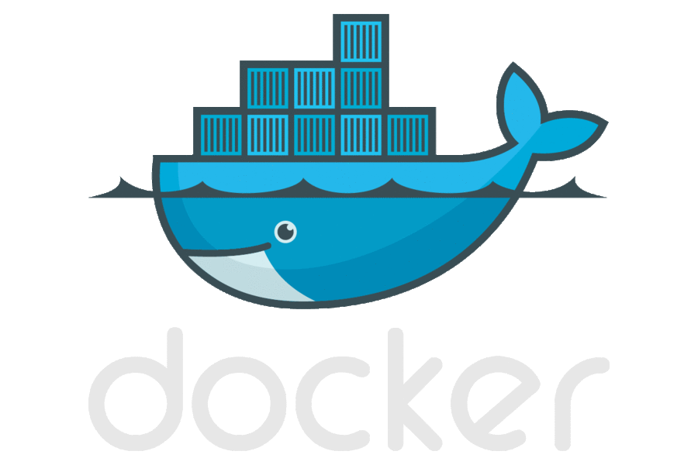


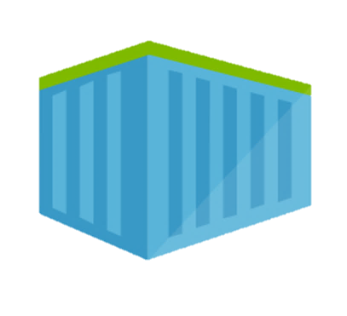
DevOps Workflow with Containers
…
2.
3.
4.
5.
Run, Manage
…
Source Code Control
(SCC)
Build/CI,
Integrate,
Test
CD, Deploy
…
Production
environments
…
Private Registry
…
Push
Code
…
1.
6.
…
Run
Code
Validate
Debug
Notes:
So DevOps should be important to your customers and should help you have good discussions with them
But let me throw out another buzzword that customers like to talk about… Containers…
Etc.
This is agnostic of which development technologies… (AWS)… But everything I show here can be done equally well on Azure…
And it can be setup so easily that your PSS and SSP should know how…

Slide 13



DevOps Workflow with Containers (Azure)
Visual Studio Team Services
…
Container Service
…
Build/CI,
Integrate,
Test
Run, Manage
Service Fabric
Source Code Control
(SCC)
CD, Deploy
…
App Services
Production
environments
…
Container Instances
Azure
…
Container Registry
…
Push
Code
…
…
Run
Code
Validate
Debug
Notes:
Source control – Maybe GitHub or BitBucket
CI/CD – Maybe CircleCi or Jenkins… Azure Marketplace
Registry – Maybe DockerHub – but hopefully ACR
Monitor – New Relic or App Dynamics – forward reference
BUT RUN IT IN Azure…
CLICK!
And if they don’t have a solution for every piece or if they’re not happy with any…

Slide 14
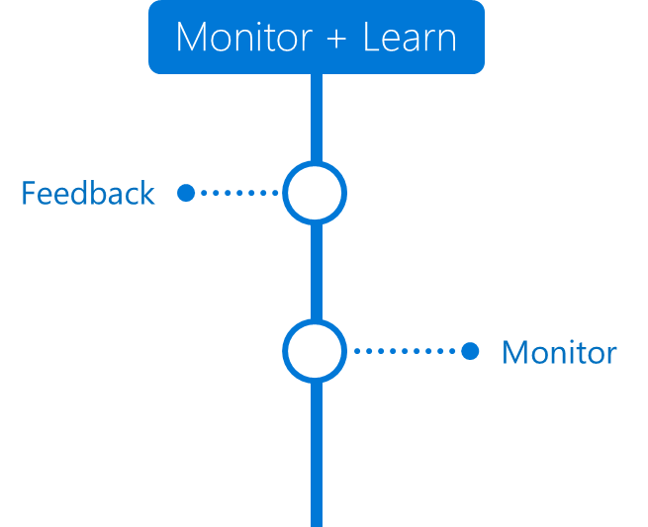
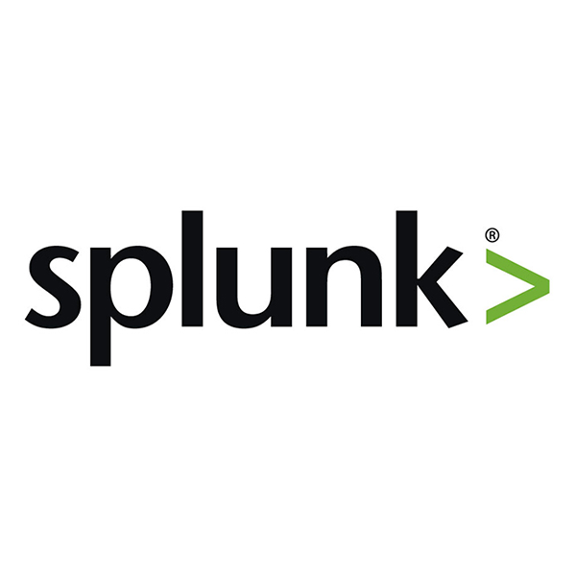


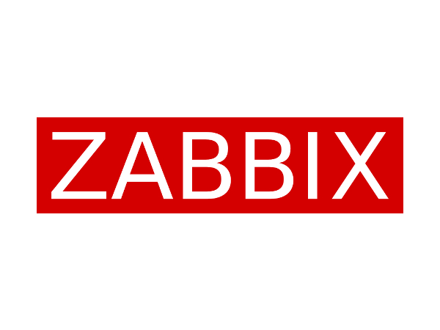
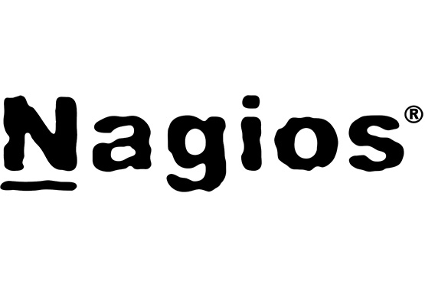
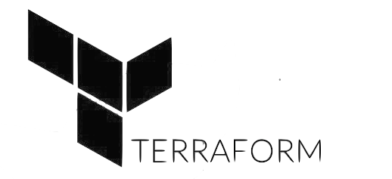
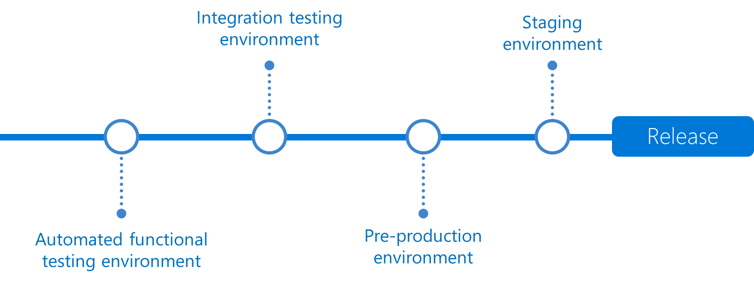
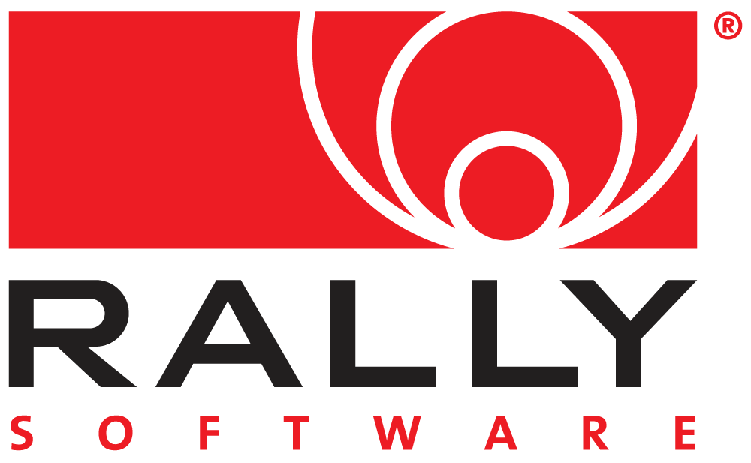



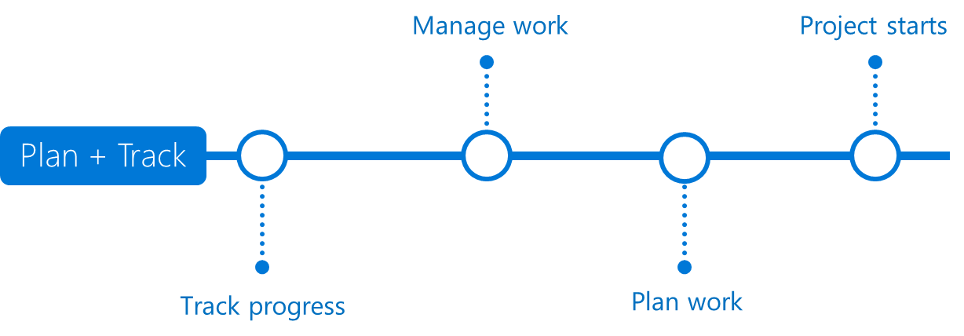
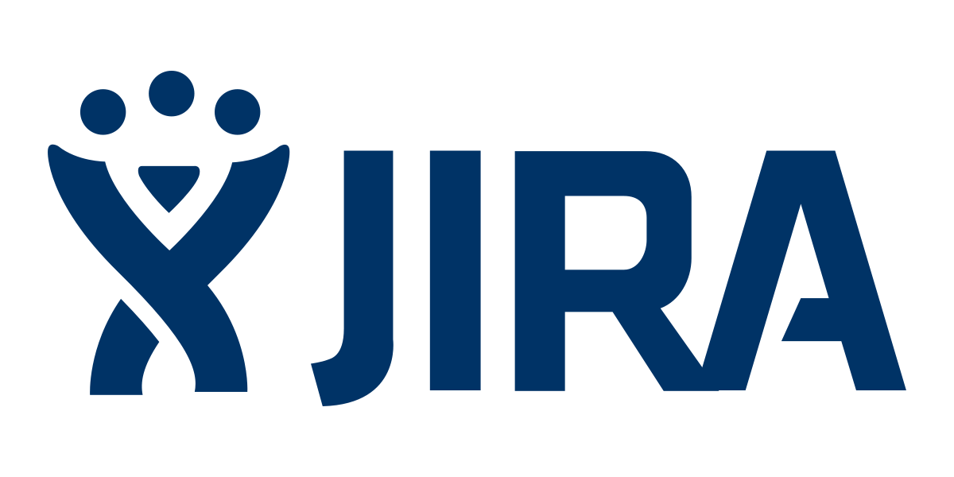

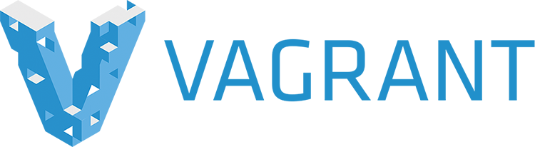





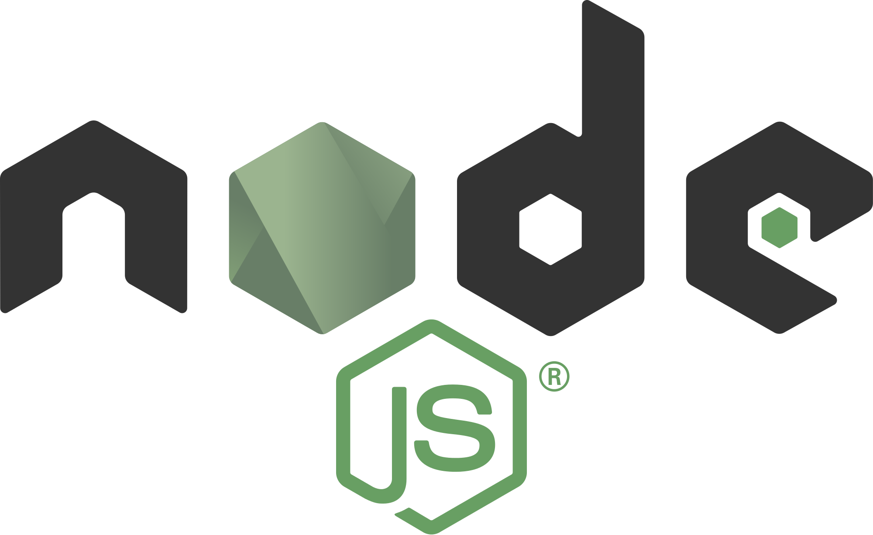

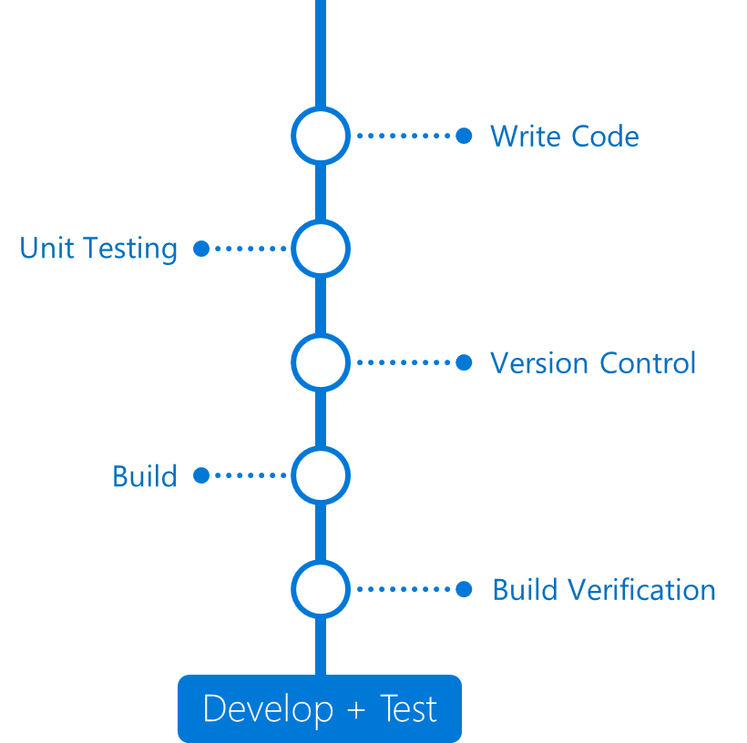

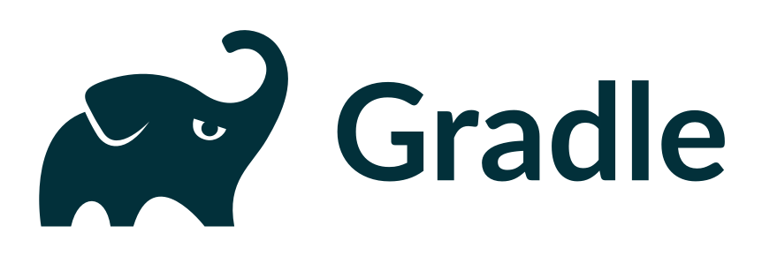

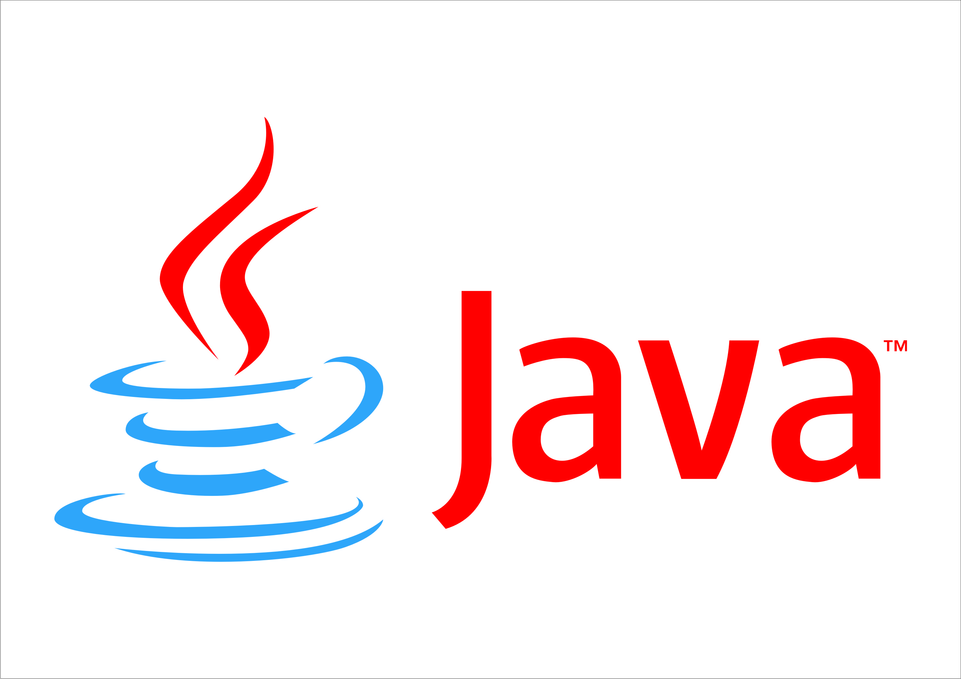
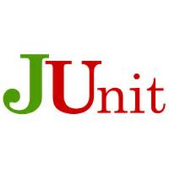
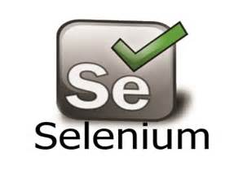
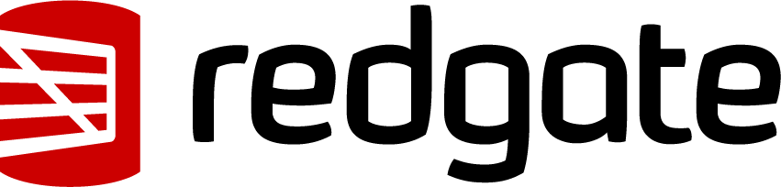
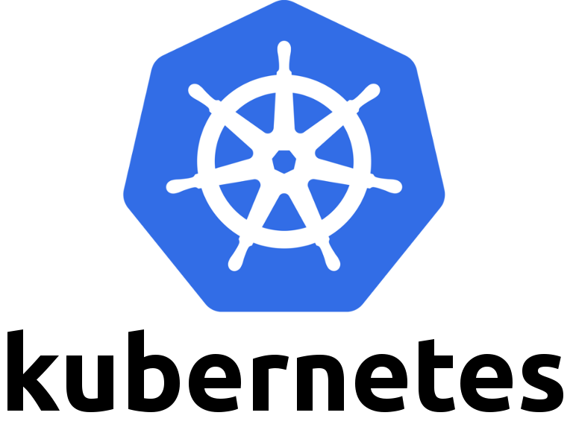

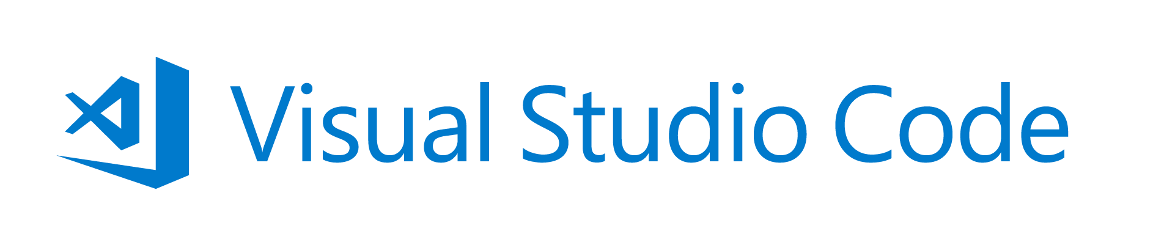


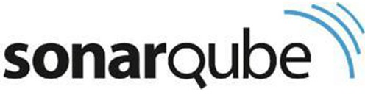
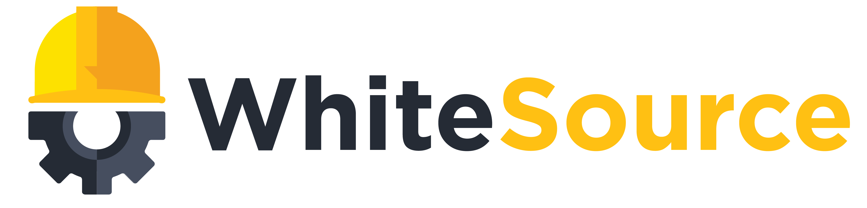
Open DevOps (with Azure)
Application Insights
DevOps
DevOps
Visual Studio

Slide 15


Use and orchestrate your favorite 3rd party tools. Your toolchain, seamlessly integrated with Azure.
“Azure support for Docker, Kubernetes, Puppet, Terraform, Cassandra, and other open source tools has become very important to us and has really accelerated our move into Azure.” – Robert Rudduck, Director of Architecture and DevOps Read the story
Notes:
When we say open, we mean allowing you to use and orchestrate your favorite 3rd party tools and platforms. Your toolchain, seamlessly integrated with Azure.
Ambit energy is a great example of this…
Ambit Energy, of Dallas, Texas, is one of the leading retail providers of electricity and natural gas in the US, with approximately 1.5 million residential and commercial customers across 16 states and the District of Columbia.
Ambit Energy provides electricity and natural-gas services in deregulated markets around the world.
Ambit Energy leverage open source DevOps tools such as Terraform and Puppet, but utilized Visual Studio Team Services to orchestrate their entire CI/CD pipeline.
Allowing them to leverage their existing expertise in these technologies and supplement with additional capabilities of VSTS.
- Quote from Tom Phillips: Vice President of Data and Infrastructure “By using Azure, we stood up an infrastructure in Japan in two to three weeks. We couldn’t even have signed a hardware P.O. in that time if we were building our own datacenter.… We simply could not have gotten into the Japanese market without Azure.”

Slide 16
Azure Web App Deployments by Sub Type
MICROSOFT CONFIDENTIAL

Slide 17


“Instead of telling people to wait for six months for a new feature, we can give it to them in a few weeks. Our lead cycles are getting much shorter, and we have business stakeholders involved so that our solutions are more aligned with business requirements..”
Johan Krebbers
IT Chief Technology Officer,
Royal Dutch Shell

Slide 18
Azure DevOps

Slide 19
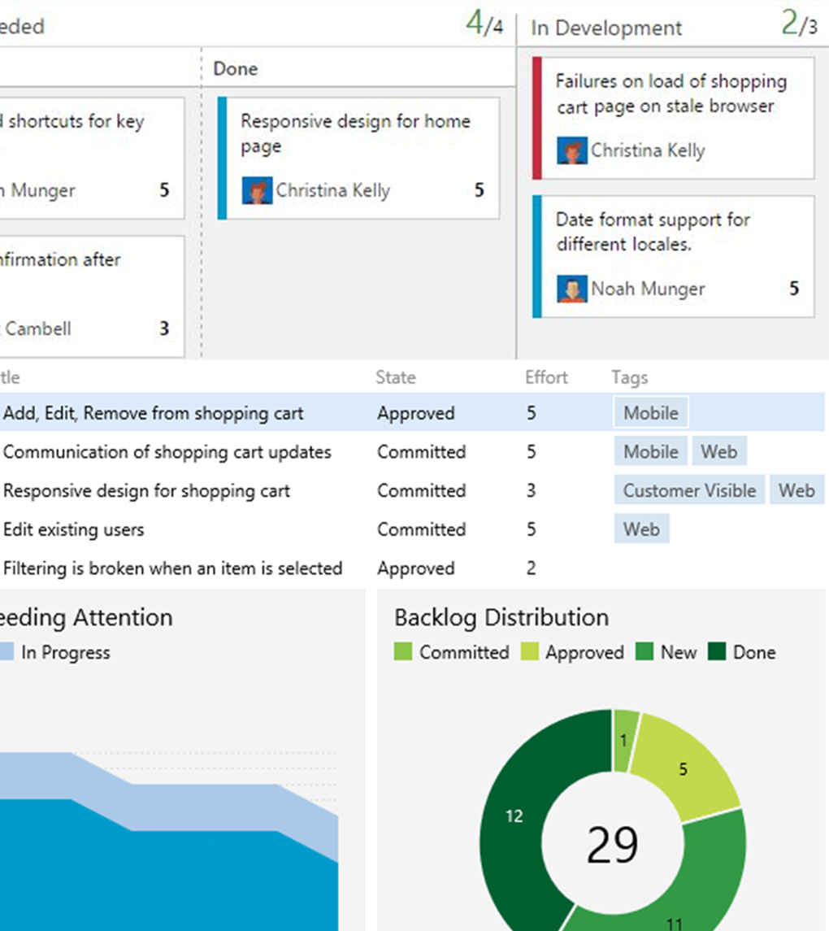
Agile planning
Tools for the entire team
Monitor all your team’s work - including operational issues - using built-in Kanban boards. Track work in progress to ensure you’ve got a streamlined channel from idea to delivery.

Slide 20
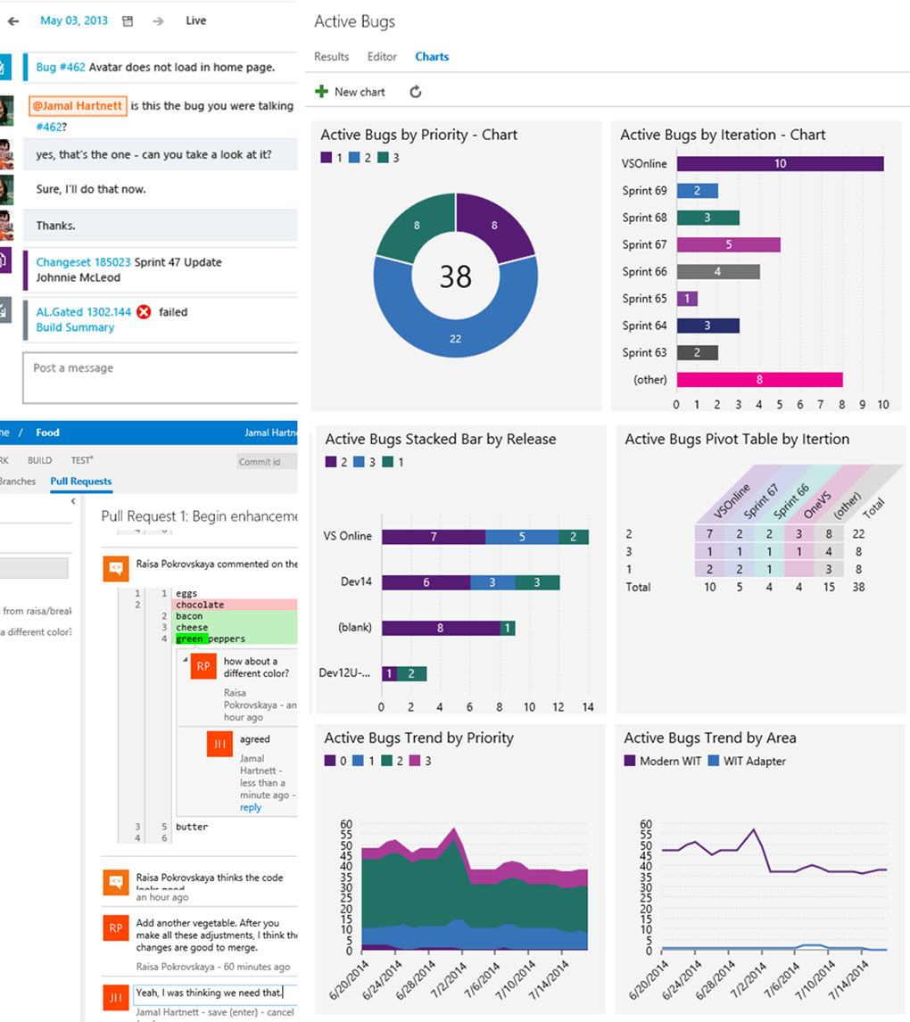
Dashboards and charts
Dashboards
Build dashboards that provide visibility to your team and stakeholders. Stop worrying where to find things and instead use Visual Studio Team Services to get everyone on the same page.

Slide 21
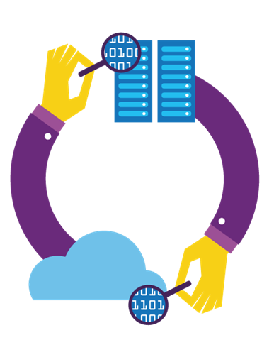
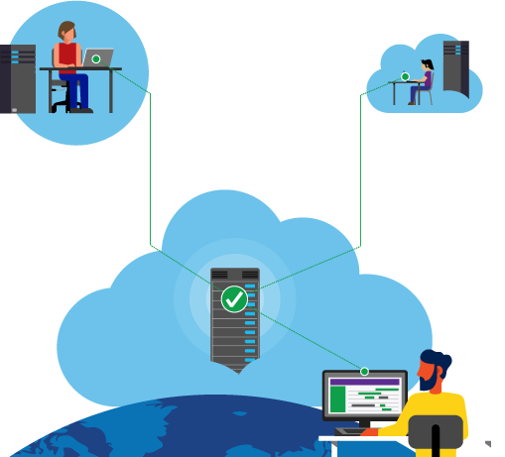
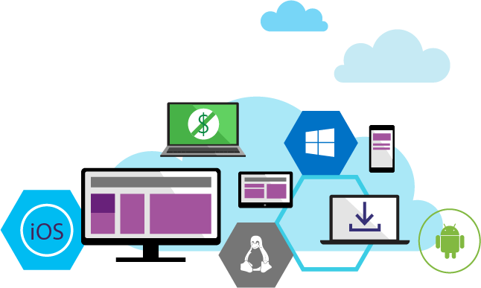

Source Code Management
VSTS and TFS provide unparalleled flexibility for your evolving codebase.
All your code is linked directly to the story, bug, or task driving the work.
Flexible version control
Collaborate on code
Any IDE, any code

Slide 22

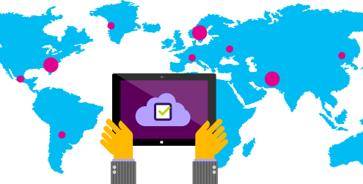
Quality Management
A toolset optimized for QA professionals, giving them flexibility in how they work while at the same time keeping them in sync with the rest of the team.
Test planning and tracking
Manual and exploratory testing
Performance and load testing

Slide 23
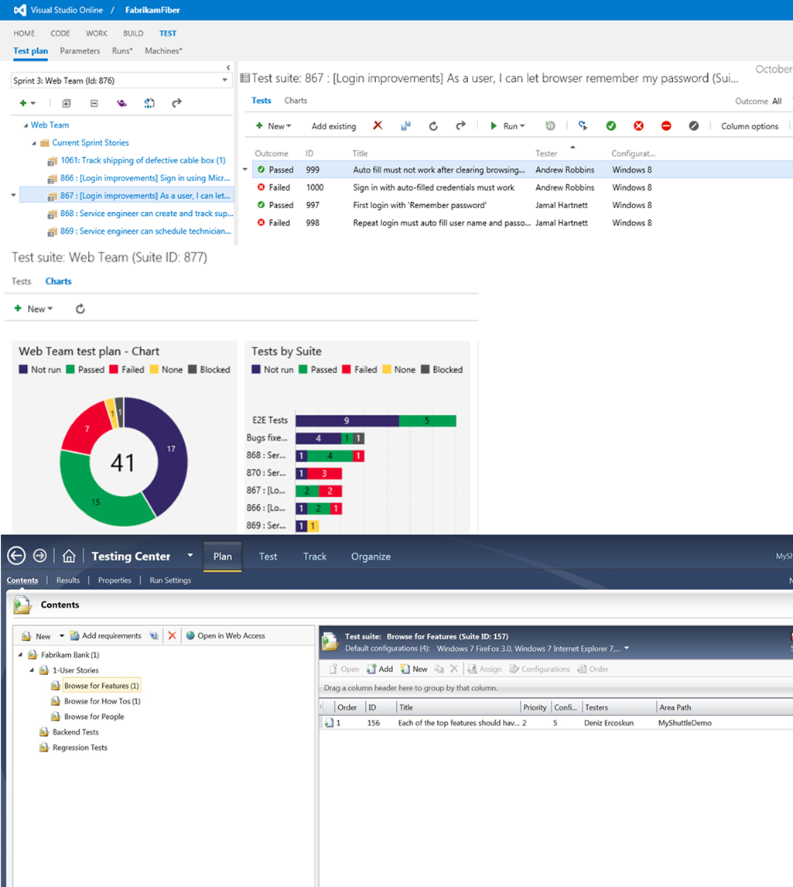
Test case management
Streamline quality
Take advantage of a toolset optimized for the needs of testers, giving them flexibility in how they work while at the same time keeping them in sync with the rest of the team. Improved web-based test case management helps testers author, manage and execute test cases using any modern web browser. Microsoft Test Manager further empowers your testers by giving them tools for automated and manual testing in a desktop application optimized for the needs of today’s agile QA professional.

Slide 24
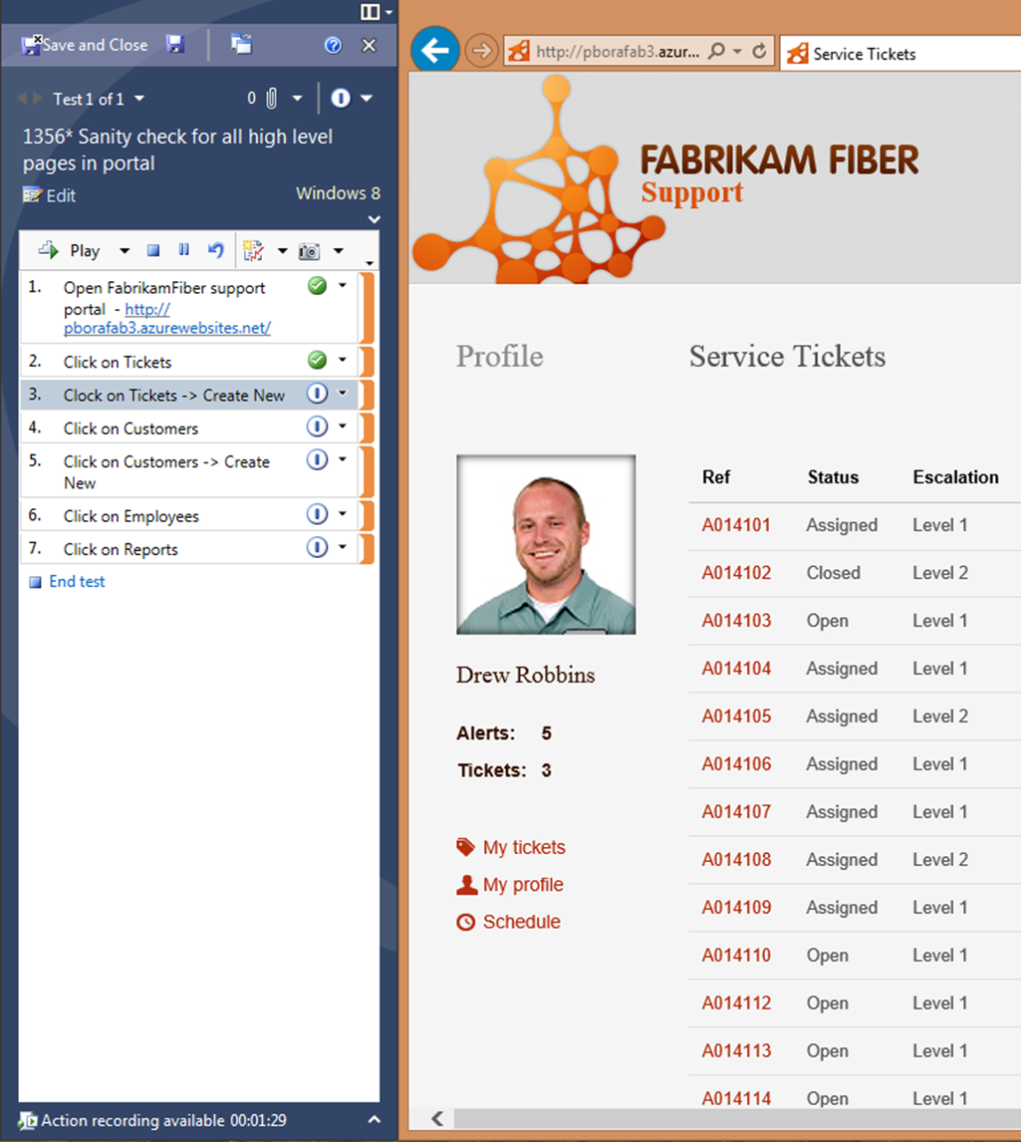
Manual testing
Run, record, play back
Capture detailed records of steps performed, behaviors observed, and the status of each test step with the fully instrumented and configurable Test Runner. Pause testing at any time to report a bug, even if it’s not directly related to the current test case. High-fidelity defect reports go directly to the development team, including all the data needed to reproduce and resolve the error quickly. Record tests for later playback to speed up test sessions and enable test automation.

Slide 25



Continuous Delivery
Streamline and automate the workflow between development and IT Ops and deliver higher quality software more frequently with less risk.
Continuous Integration
Release Management
Continuous Quality

Slide 26
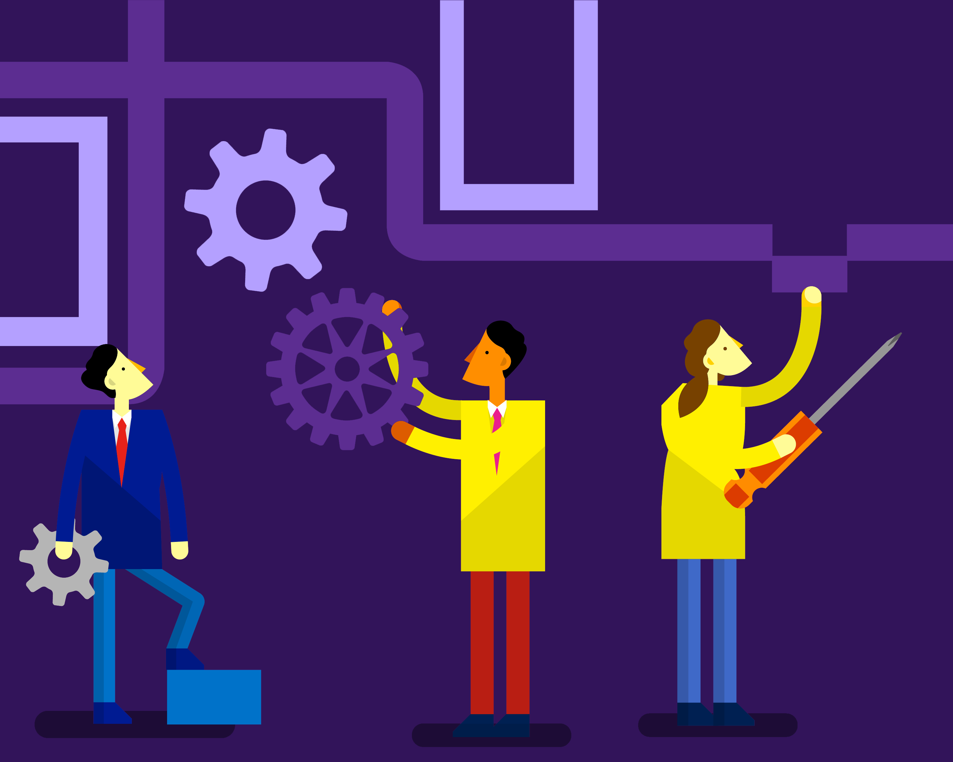
Cross-platform Build
No matter what tools you use or what language you prefer - Team Foundation Build builds your app your way, for your platforms. Just open your browser!
Cross-platform build for iOS, Java and Android
Flexible, extensible and customizable builds
Cloud, hybrid or on-premises infrastructure

Slide 27



Tools for any Developer
Code
Team Services
Team Foundation Server
For Mac
Windows
Linux
iOS
Android
.NET C#
C++
JavaScript
PHP
Python
Node.js
R
Cordova
Unity
Java
Perl
Xamarin
PowerShell

Slide 28
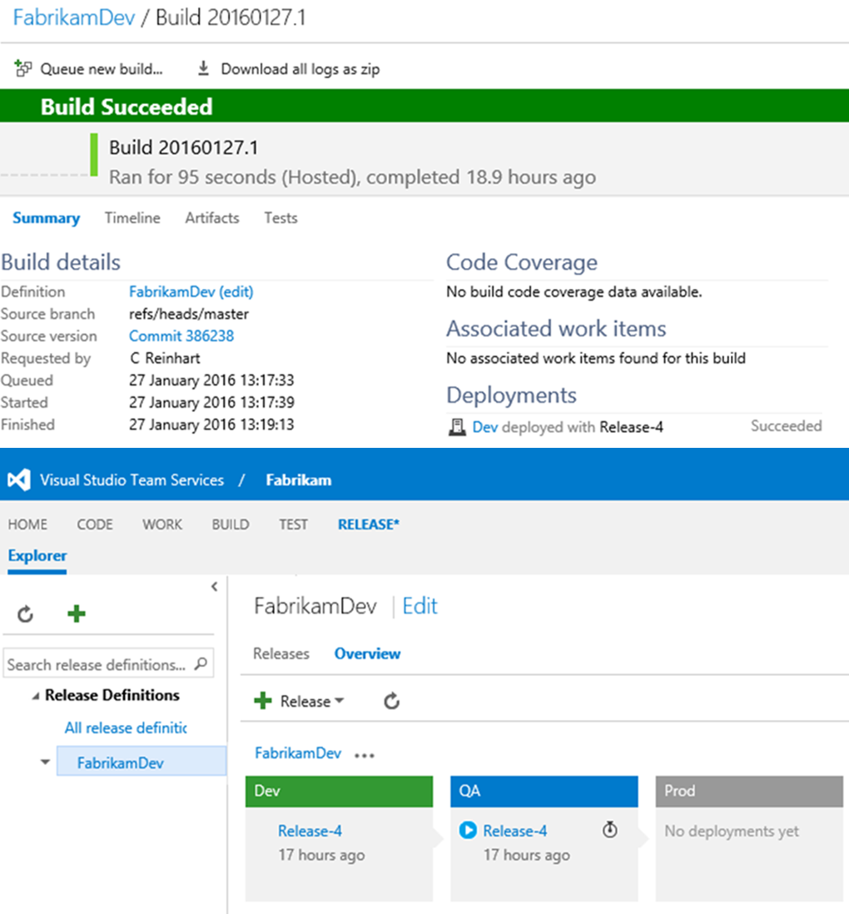
Release Management
Ship better apps, faster
Visual Studio Release Management makes it easy to automate deployment and testing of your applications in multiple environments. Teams can create release definitions and automate deployment in repeatable, reliable ways while tracking simultaneous in-flight releases. Easily incorporate automated functional tests or manual approvals in a release definition to automate the release process all the way to production.

Slide 29
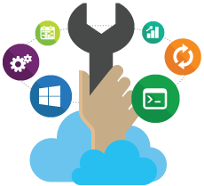

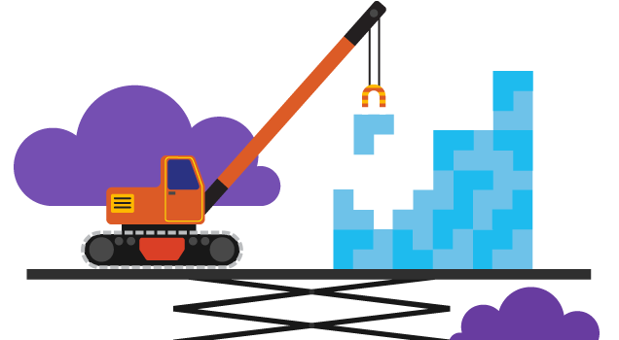
Extend, Customize & Integrate
Customize and extend the Visual Studio platform and create the perfect development environment that you'll love as much as your code.
Open platform
Extensions
Visual Studio Marketplace

Slide 30
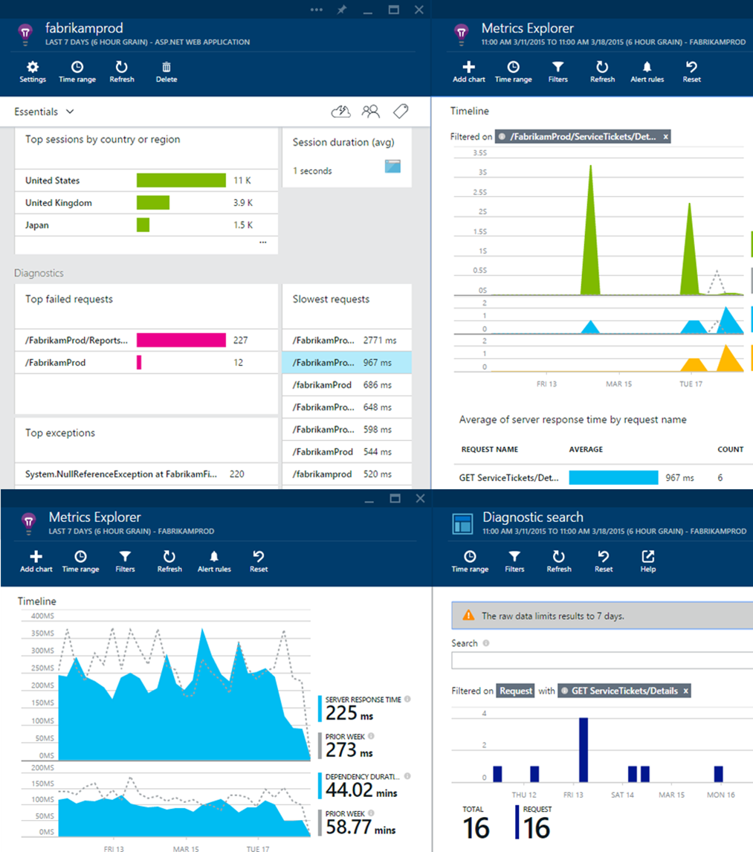
Application Insights
Track usage and performance
Get a 360° view of your app that includes availability, performance and user behavior. Use a powerful and easy-to-use experience to track and improve the success of your application. Analyze data across dimensions and make informed decisions about your product’s future.

Slide 31
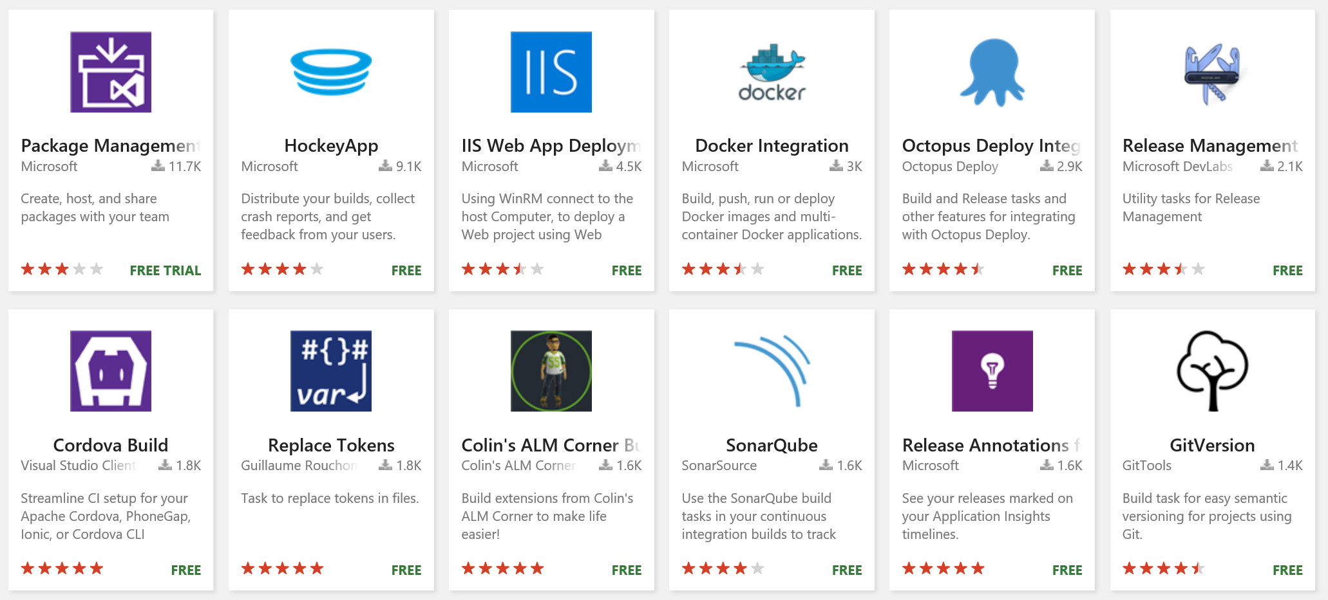
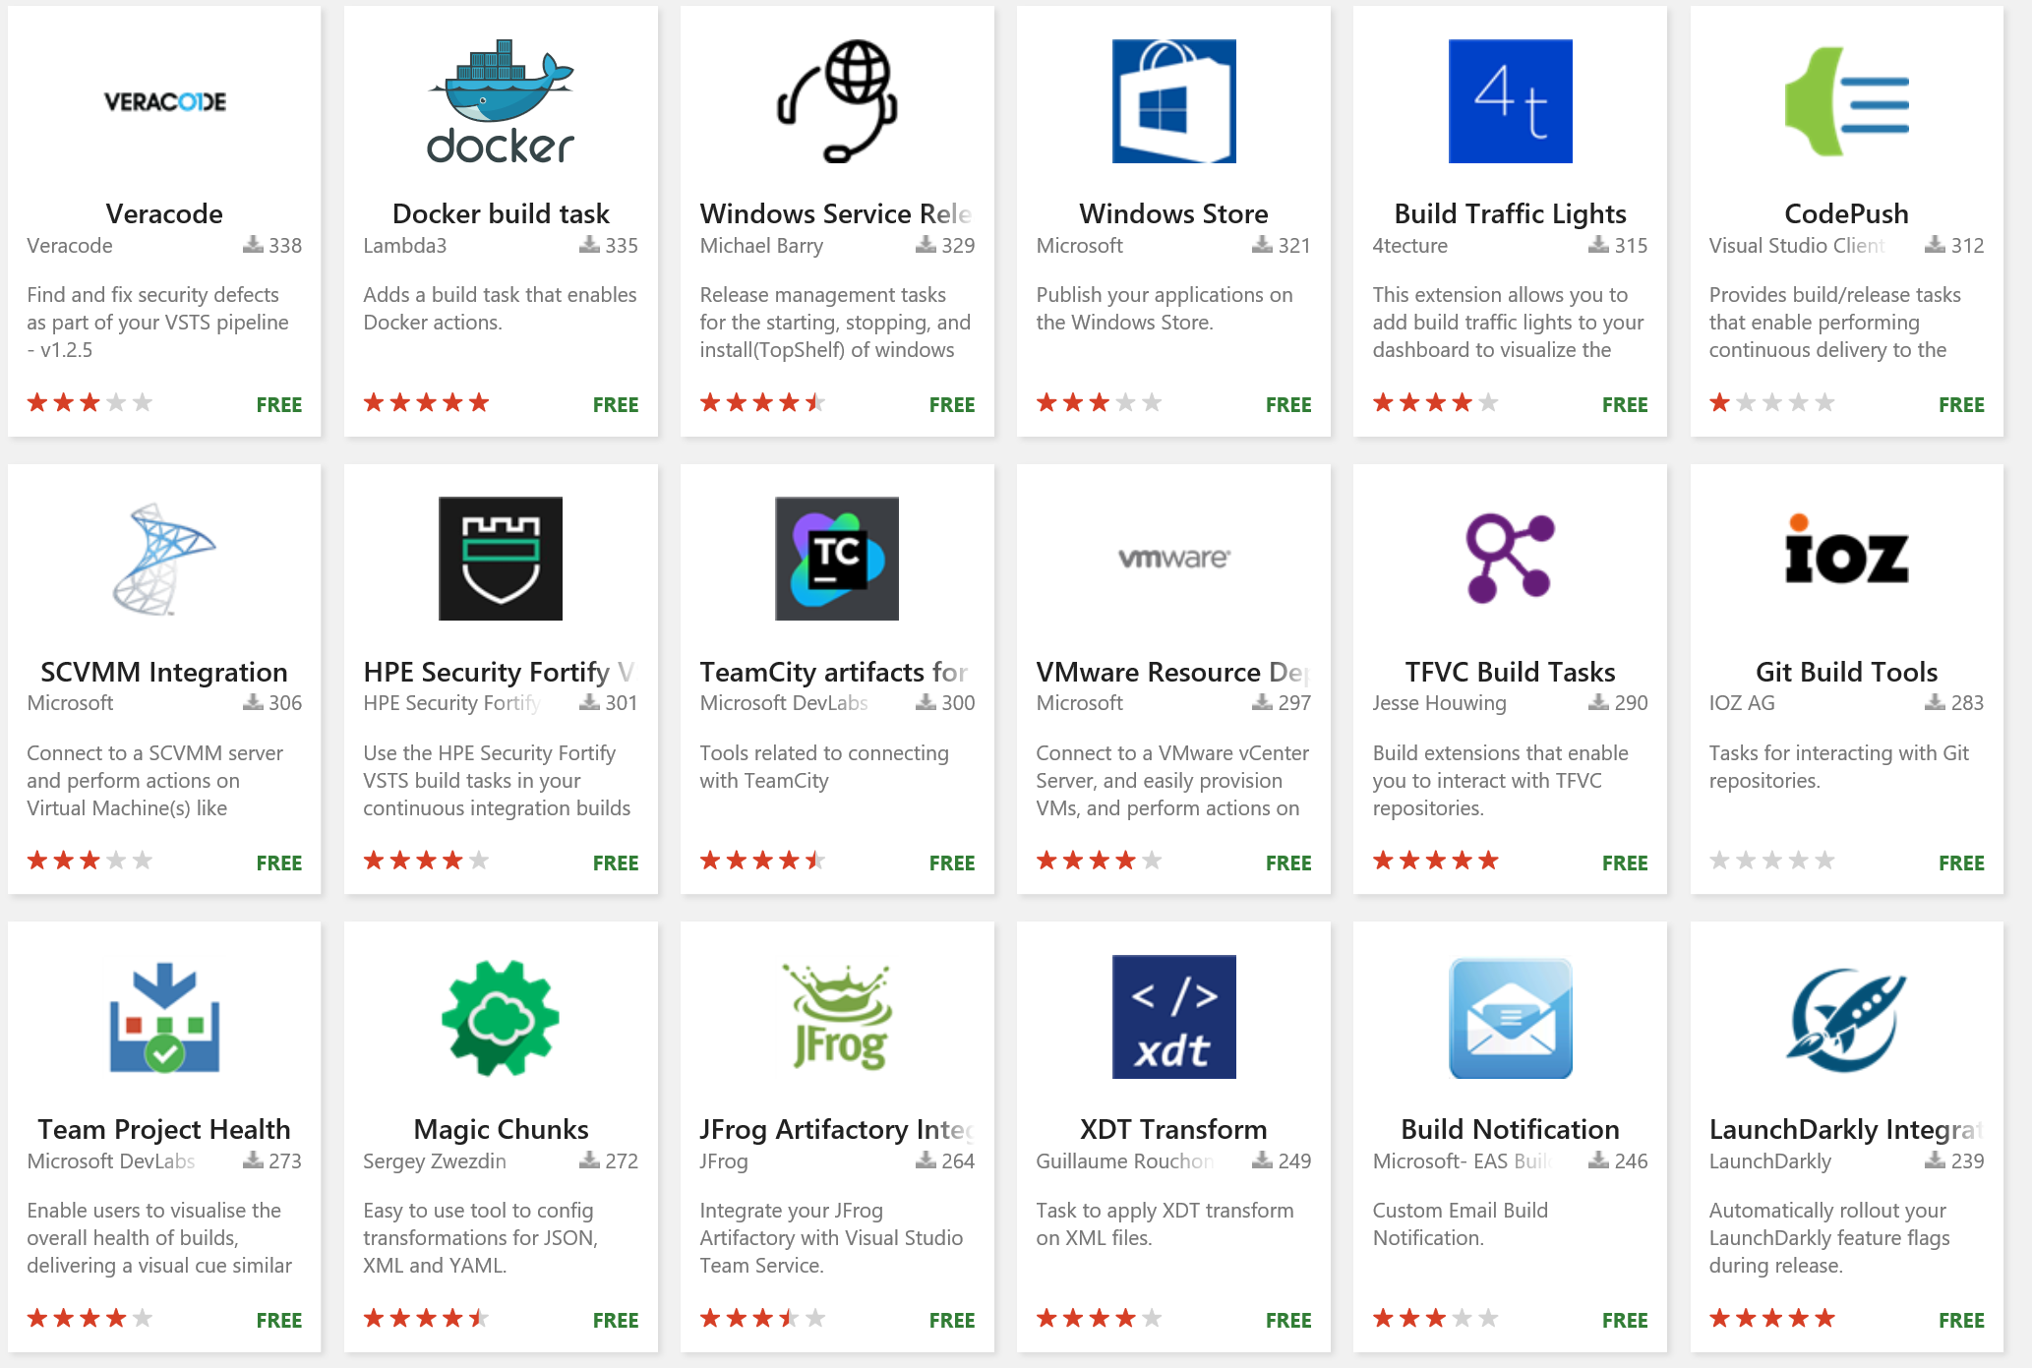
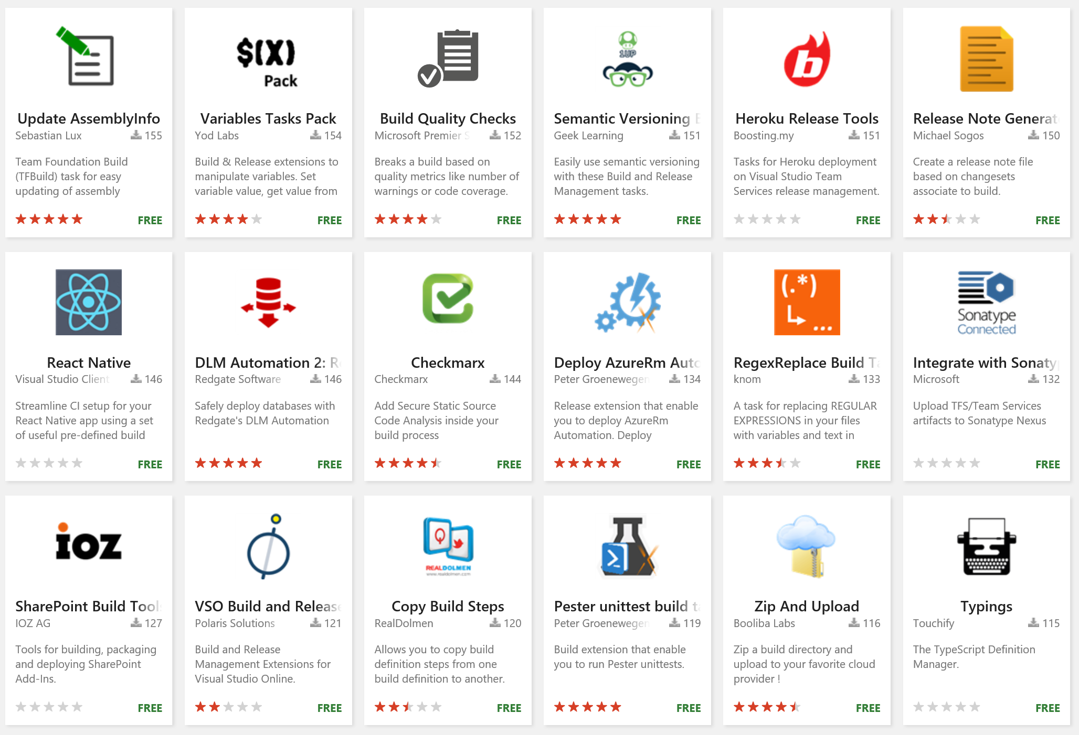
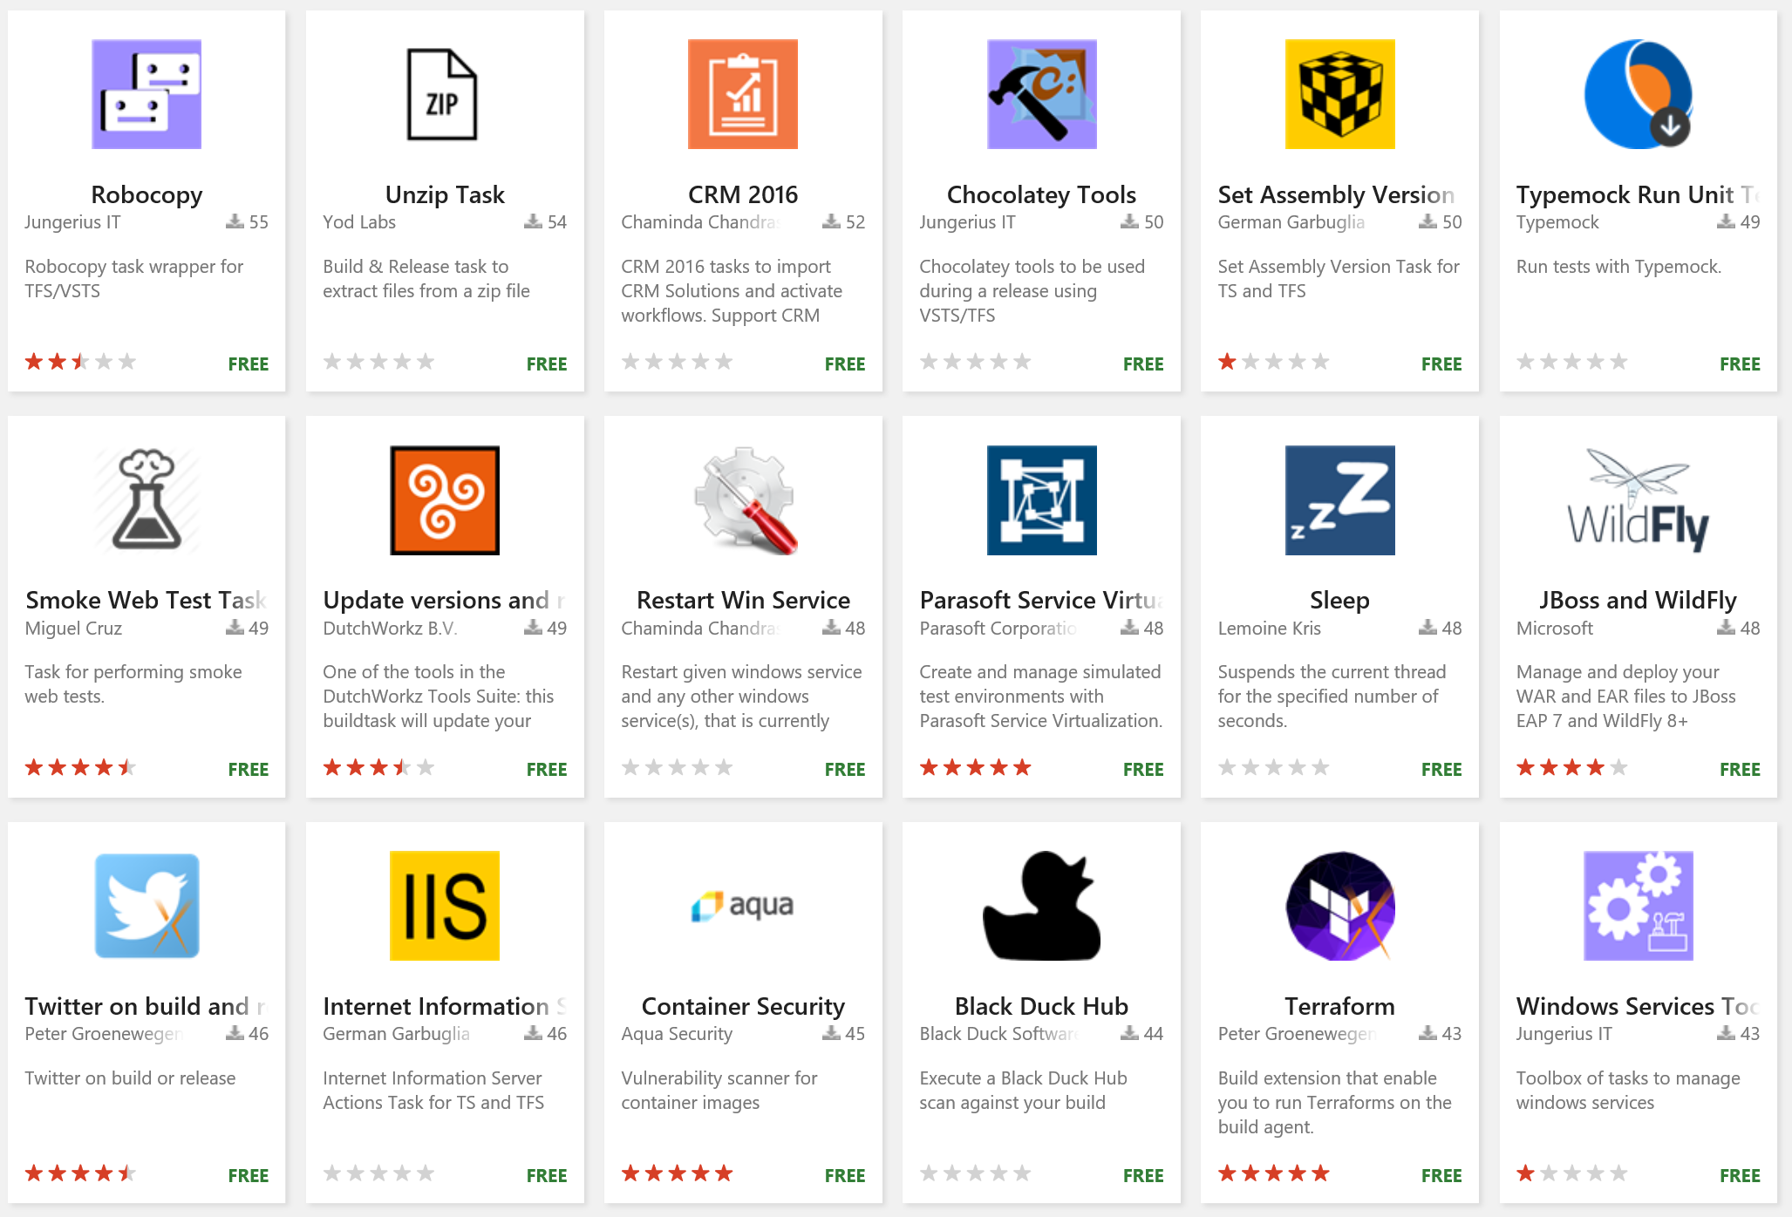
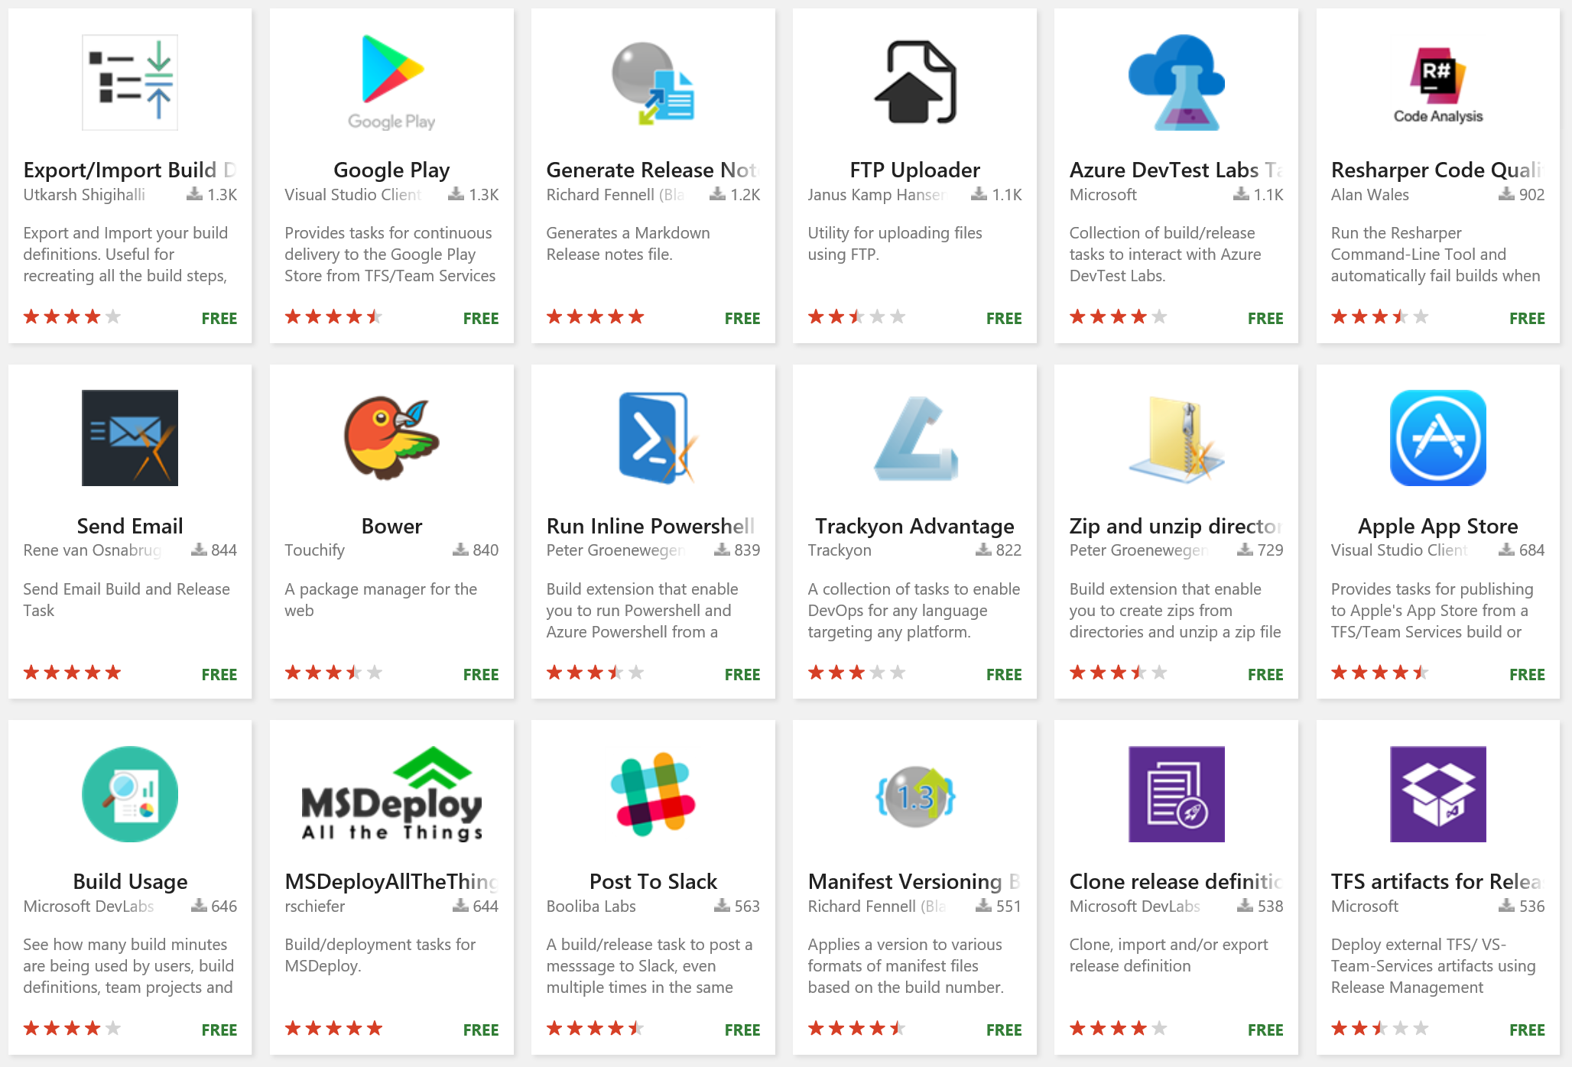
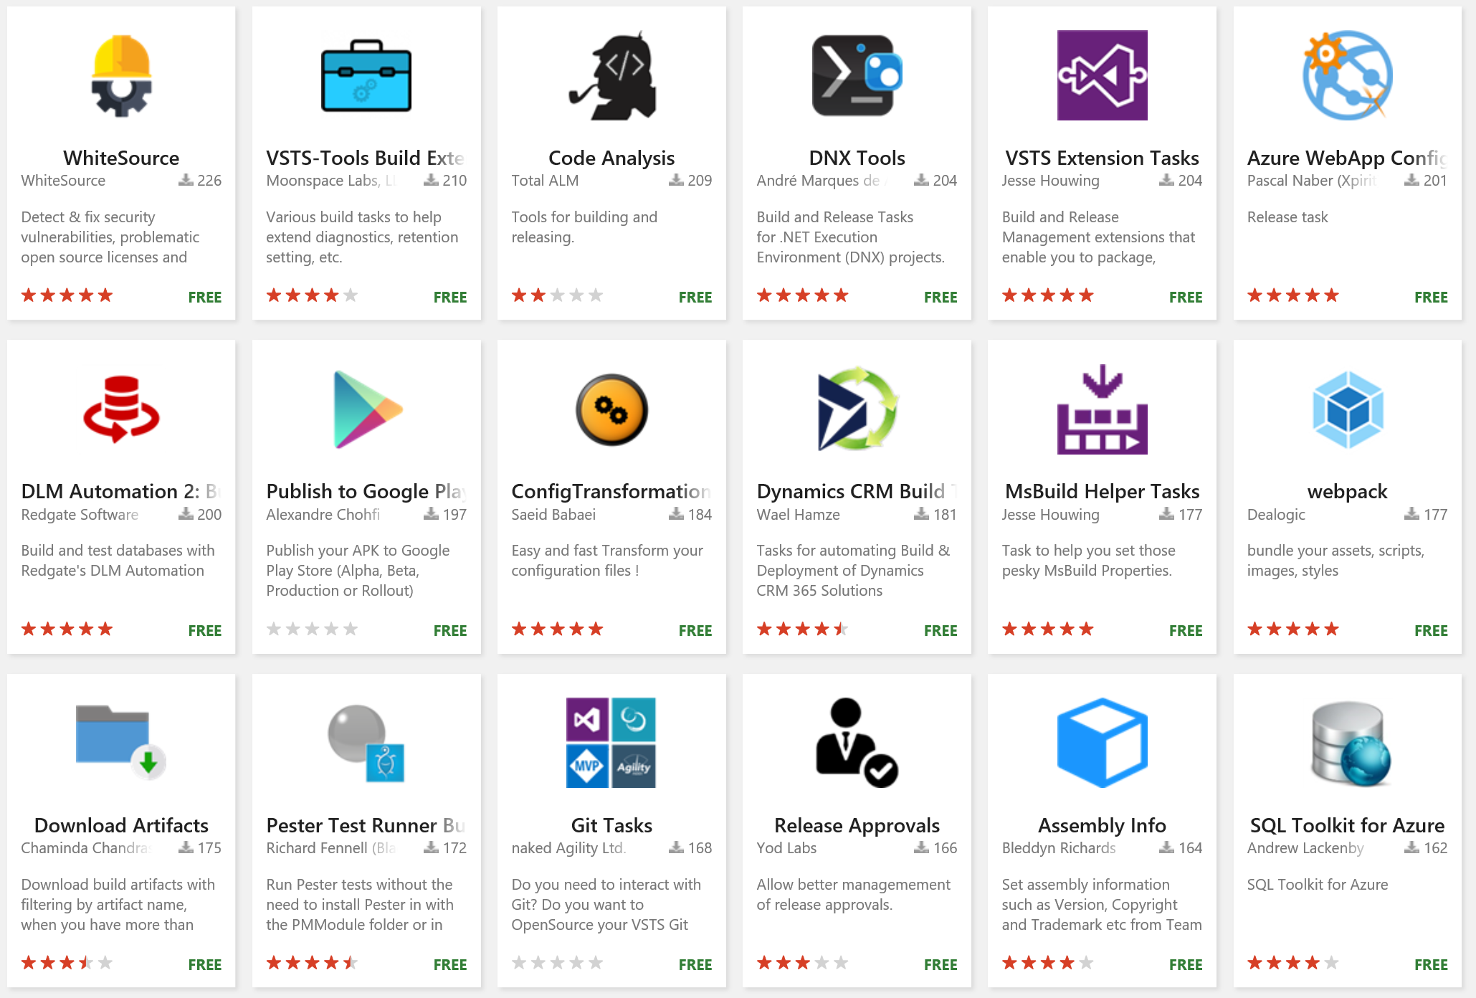
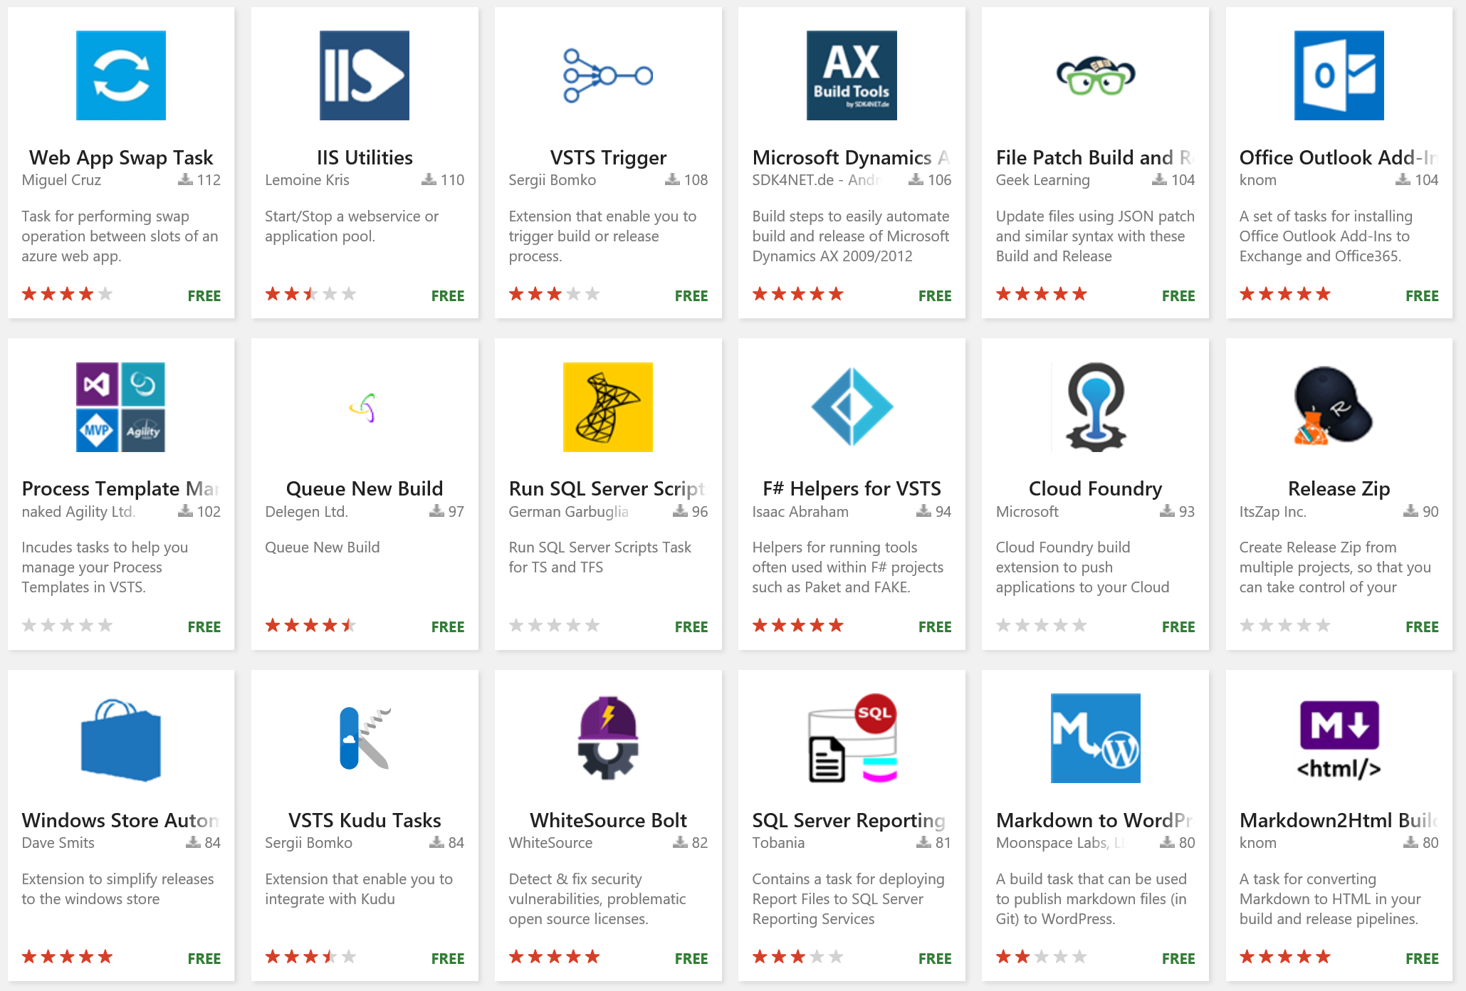
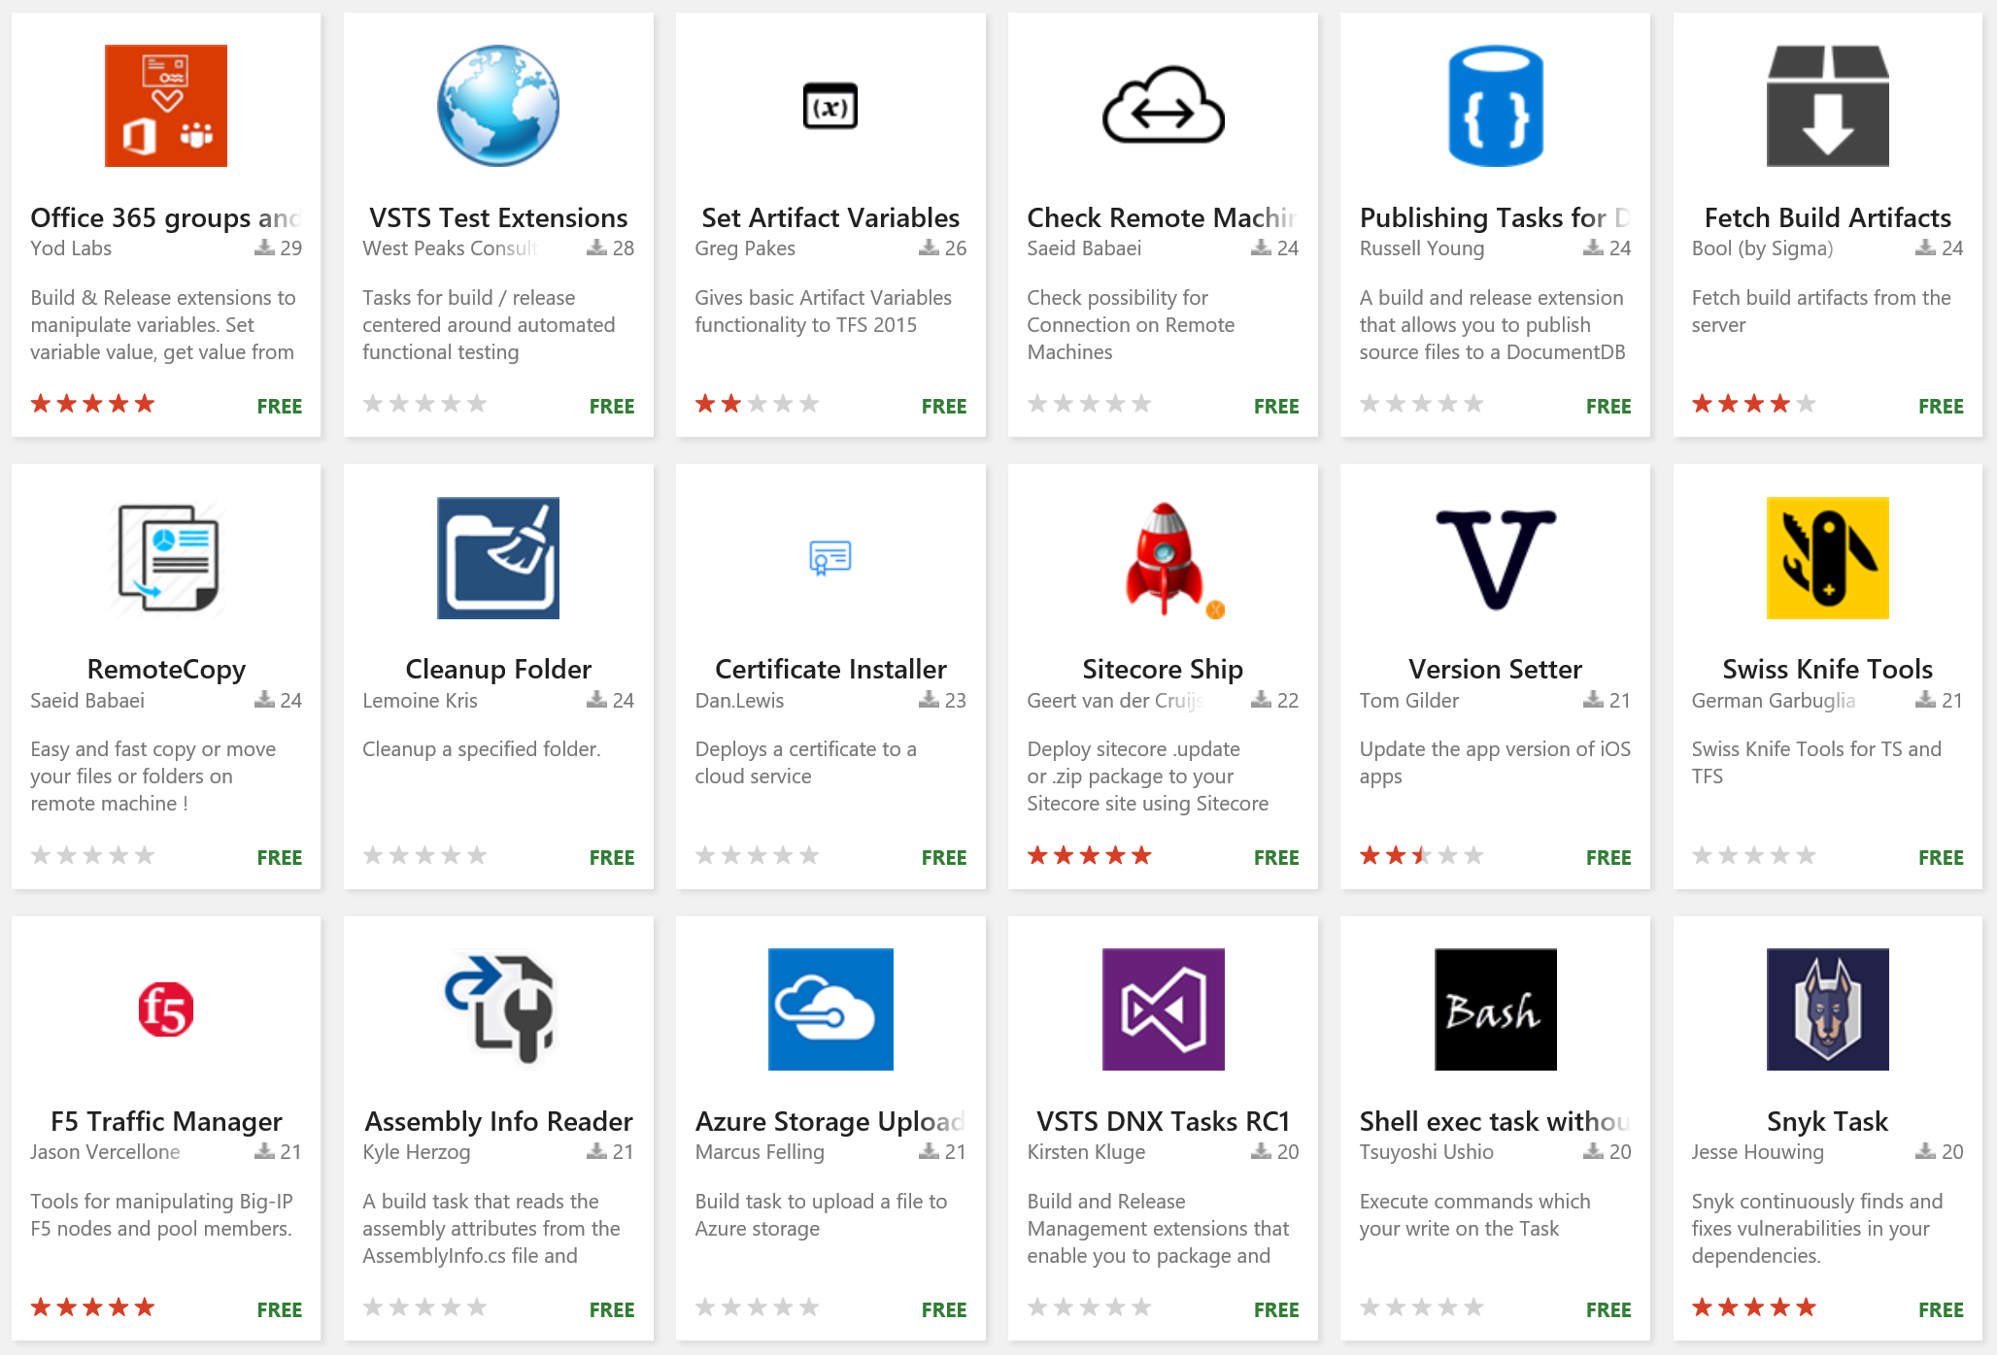
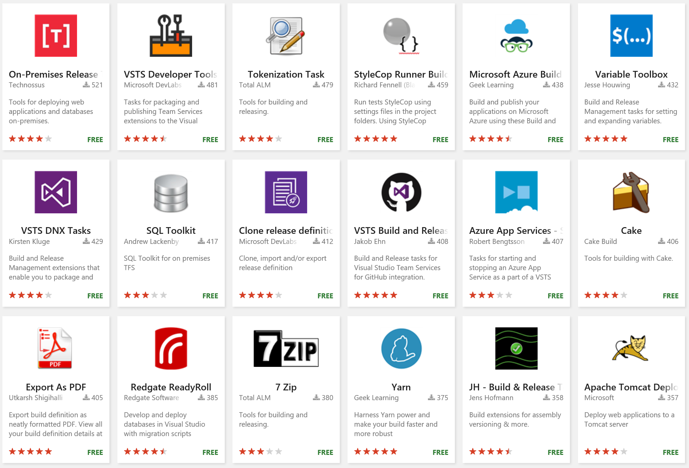
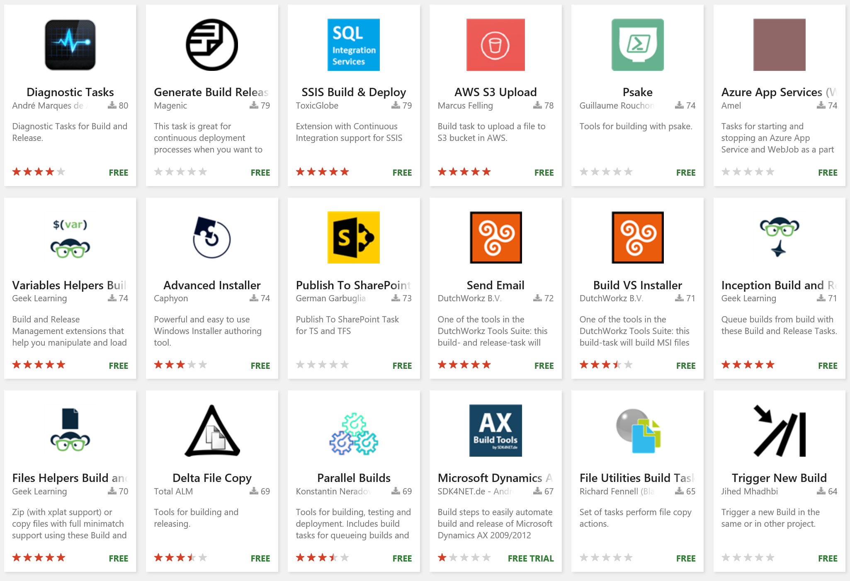


Extensions
Over 500 extensions for VSTS ad TFS covering all elements of the project lifecycle and integrations with popular commercial and open source tooling

Slide 32

DevOps with VSTS
DevOps
DevOps is the union of people, process, and products to enable continuous delivery of value to our end users.
Application Insights
DevOps
DevOps
Visual Studio
Notes:
Continuously delivering value is about more than just automating deployments. You must start at the beginning of your development process - what you plan to deliver and how you plan to get there. In other words, planning and tracking.
[CLICK – Transition slide to show Planning phase]
Your project starts with an idea and a plan how to turn this idea into reality.
Agile approaches software development by emphasizing incremental delivery, team collaboration, continual planning, tracking and learning.
​
[CLICK – Transition slide to show development and test phase]
Although planning starts the process, the development team turns the ideas into features and capabilities during the development and testing phase.
Your development team will use the practice of continuous integration to merge code and automatically run a build process, including tests, whenever they commits a code change. ​
​
[CLICK – Transition slide to show release]
Continuous delivery will deploy your build to testing, pre-production, staging, and other environments in the release process.
It gives you quality gates throughout your release pipeline and increases confidence in your code long before production. ​
​
[CLICK – Transition slide to show monitor]
Lastly, you need to watch your solution in production. Effective monitoring delivers information about your solution’s performance, usage, and issues.
It’s essential to enable DevOps teams to deliver at speed, get feedback from production, and increase customers satisfaction, acquisition and retention.​
[CLICK – Transition slide to show other products and end with VSTS]
​Whether you are targeting the cloud, hybrid cloud, or an on-prem environment, Visual Studio Team Services, or VSTS, is the recommended Azure DevOps solution.
It allows you to plan, monitor, build and deploy to Windows, Unix, Android, or iOS, from .NET, Java, PHP, Python, Ruby, C++, and many other 3rd party and open source products such as Ant, Maven, Gradle, Junit, NUnit, xUnit, and Jasmine.
If you cannot find a task needed for your release pipeline, you can build custom tasks that integrate with VSTS and your continuous integration and continuous deployment.

Slide 33

Gartner
“Microsoft offers a broad suite of functionality available either on-premises or in the cloud. Growing support for open source technologies and community participation aides in opening up the tools for a broader set of platforms.”
2015 Gartner Magic Quadrant Application Development Lifecycle Management

Slide 34
What we have learned from our Journey?
VSTS

Slide 35


Lessons learned on our DevOps Journey
VSTS Preview
VSTS GA
1ES
Sprint 1
August 2010
Sprint 29
June 2012
Sprint 64
April 2014
Sprint 67
June 2014
Sprint 138
Jul 2018
Features delivered per year
https://aka.ms/DevOpsLessonsLearned

Slide 36
Questions?

Slide 37
Thank you!

